Slide 1
INDIA'S LITERACY & EMPLOYMENT ANALYTICS VISUVALIZATION PROJECT
Prof. Paolo Buono
ALEX PRAVEEN DASS
(MAT NO: 725190)

Slide 2
INTRODUCTION
This is a Case study of Literacy, Labour Participation, Employment, Unemployment and Remedies in India. Economic development results in distribution of wealth.
Labour force participation is inherent to any country development. Labour participation depends on social indicators like good health care, access to clean water, high literacy rate etc. Gaps in above indicators results in unbalanced growth and unemployment.
Increase in government spending on these indicators results in distribution of income equally.
Data Dictionary
Gender wise Literate comparison
State wise Literate comparison
Labour Participation
Literacy vs Expenditure in Education
Labour participation rate.
Employment sector wise distribution
Unemployment in India
Remedies

Slide 3
TABLE OF CONTENTS
01
02
03
04
05
06
EXISTING LITERATURE
MOTIVATION
DATA PREPARATION
BUILDING A VISUALIZATION
VISUALIZATION &
PRESENTATION
FINDINGS & CONCLUSION

Slide 4
“The purpose of visualization is insight, not pictures.”
—Ben Shneiderman

Slide 5
01
EXISTING LITERATURE

Slide 6
Existing Literature :
What is Data visualization?
Data visualization is the graphical representation of information. Bar charts, scatter graphs and maps are example of simple data visualizations that have been used for decades.
Technology combines the principles of visualization with powerful applications and large data sets to create sophisticated images and animations.
Why Data visualization?
Computer system generate and store massive and growing amount of data .Data visualization offer one way to harness this infrastructure to find trends and correlations that can lead to important discoveries.
Representing large amounts of disparate information in a visual form allows you to see patterns that would be buried in vast, unconnected data sets.

Slide 7
02
MOTIVATION

Slide 8
The motivation for this project primarily aims about the India 2025 Development Movement, Here I have constructed a scenario in which a Central Home Minister aims to deal with the current unemployment issues, Illiteracy Rate, Agricultural Protection and State policies for successful Industrialization. So as soon as the Minister was elected he appointed a group with 10 experts from Human Rights, Reserve Bank of India and Income Tax department research and analysis wing to look into the insights of the ongoing issue to resolve them in his period of Authority.

Slide 9
03
DATA PREPARATION

Slide 10
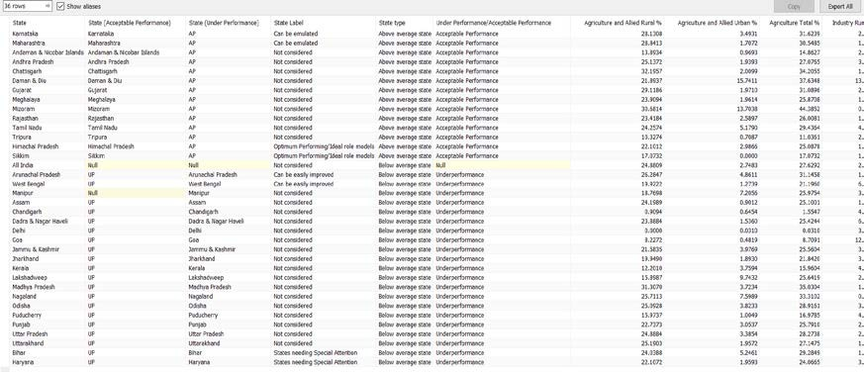
DATA CLEANING &FILTERING
The data set downloaded from the government’s data website which consist of many surveys regarding the GDP, Unemployment, Employment and other related resources for this project.
They downloaded a multiple data sources in order to do multiple analysis in different charts.
The data looked already cleaned with desired columns but they were some null values and duplicated or repeated fields
Null values are removed manually by the tableau itself and in addition we have checked in the data interpreter option which is meant to show the data clean and clear.

Slide 11
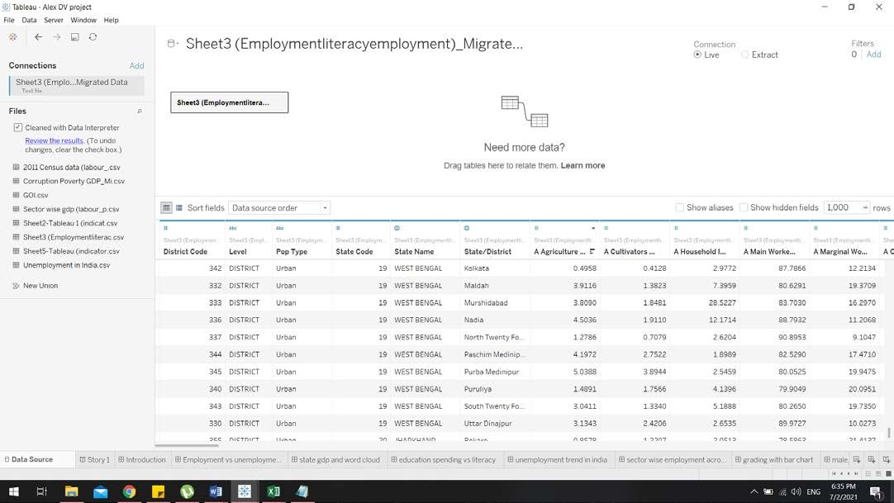
The main motto is to have a multiple data sources in the same workbook, but not merging or mixing their data.
The steps are followed as:
Connect to the primary data source as usual and See connecting to the Data for more information.
Create a Worksheet, This Worksheet will use data from your initial data source. Create a new Worksheet.
Select Data > New Data Source using the top menu bar.
Connect to a new data source and, if necessary, export the tables.
If we want, we can go back to the last created Worksheet to see the fields in the new data source ready to use.
Repeated these steps as many times we wanted to add as many data sources and worksheets.
This data is classified as quantitative data

Slide 12
04
Building a visualization

Slide 13
Framing research question
What are the three major sectors people fall under?
Which states have higher LPR, Literacy, GDP, workers percentage?
How is the unemployment rate fluctuate throughout the years?
How corruption is affecting the employment?
Employment vs Unemployment and how unemployment can be decreased?
How literacy is affecting the agriculture?
Is male and female are equally illiterate?
What is the state wise Illiterate and literate contribution?
How is the Literacy rate and Expenditure related to
education?
What are the distribution of labour force participation rate?
What is labour force participation vs gross enrolment ratio, mean year in school, literacy rate and poverty line?

Slide 14
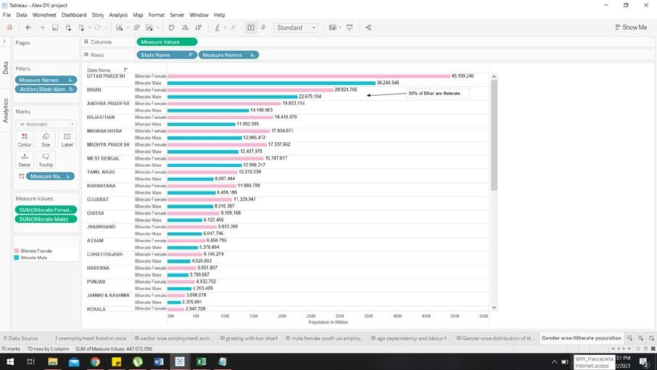
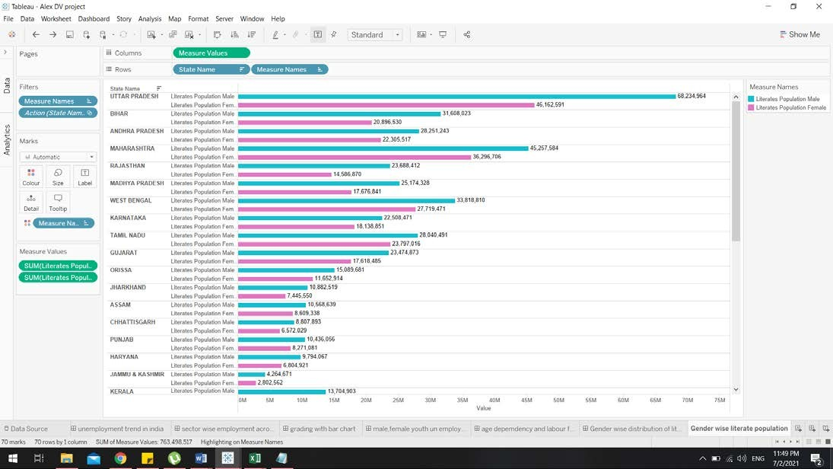
Research questions and its answer by data visualization:
Is male and female are equally illiterate?
India overall literate and illiterate gap between Male and Female is 8%, which indicates developing economy status. Among Economically well-off states Tamil Nadu and Maharashtra has the high literacy level, hence thin gender literate gap.
• North Eastern States fares far better than other States.
• Kerala’s gender literate gap is the lowest.
• Among southern states Kerala has high literacy level .
• Northern States like Uttar Pradesh and Bihar constitute largest concentration of Illiterate Population.
• Due to population exploitation land availability for economic activity and over dependence on agriculture.

Slide 15
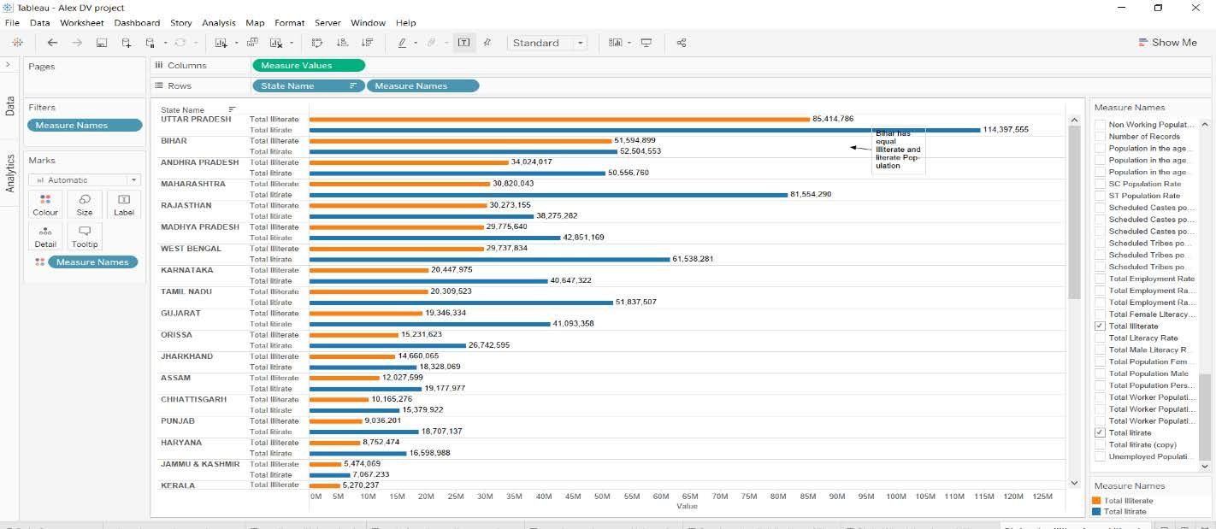
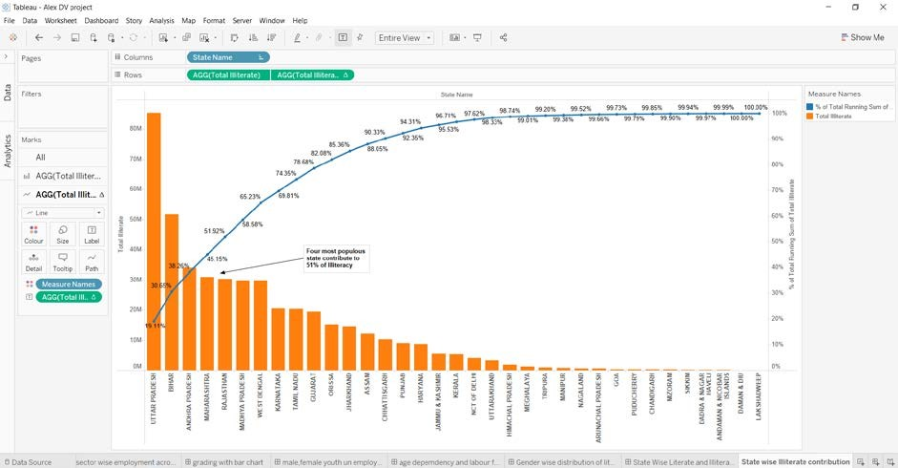
What are the state wise Illiterate and literate contribution?
Northern India constitute major part of literate and illiterate population.
The four most populated States has the high rate of illiteracy.
The reason being the percentage is less in illiteracy but the states being on the top is because in the total population of a high populated northern state both literacy and the illiteracy rate is at the same ration hence lesser the percentage of illiteracy but higher in number comparative to the other states.
By analyzing this visually we can understand that there is a less gap between literal and illiterate people in Northern States.

Slide 16
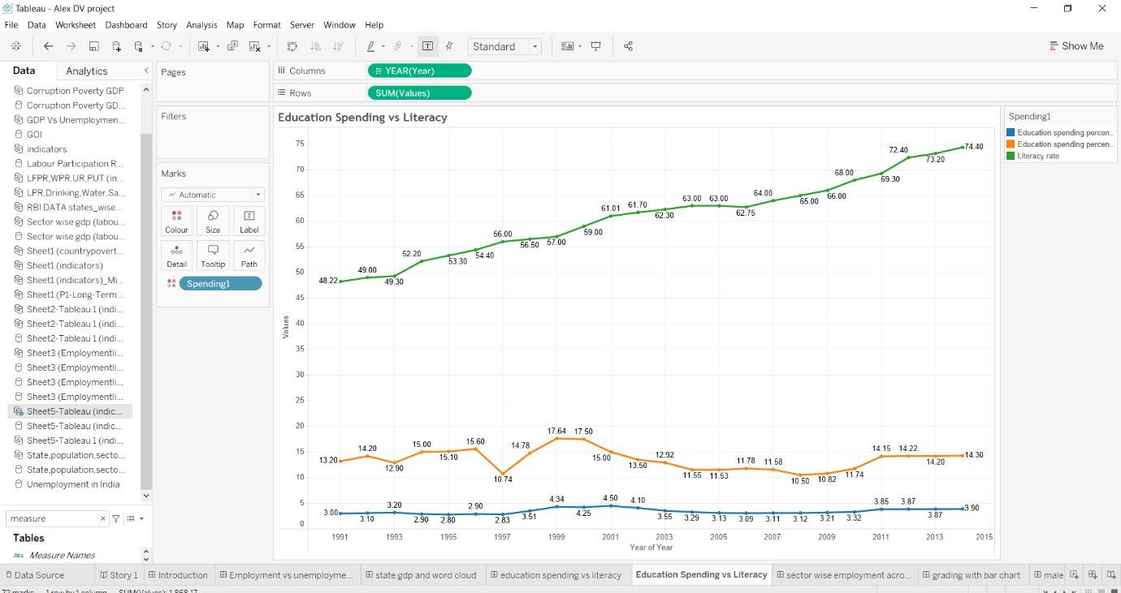
How is the Literacy rate and Expenditure related to education?
The blue line which starts at 3% and goes up to 3.90% from the span of 1991 -2015. So we can understand that the Education spending percent of GDP in a public university/school hasn’t dramatically increased much.
•We also can see the Education spending of the government in 1991 was at 13.2 and by the end of the year in 2015 it was a slight increase to 13.90.
•As far as our understanding we can conclude that the spending done by the government and the citizens doesn’t increase as such but there is a question of how the literacy rate got increased?
•To answer that we understood that almost 64.3% of people get there education in private universities/ schools.

Slide 17
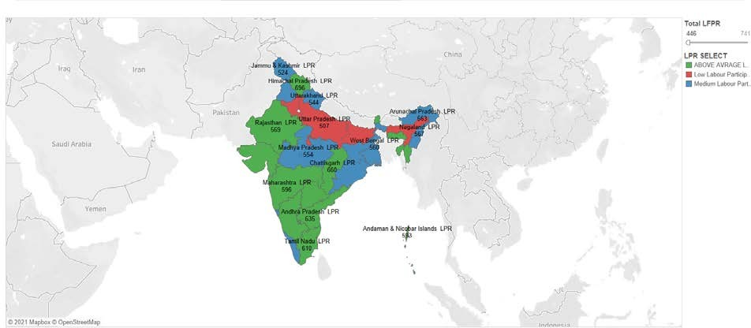
What are the distribution of labour force participation rate?
This chart indicates state Wise Distribution of Labour Force Participation Rate
Economically developed States show higher LPR than economically starved states.
Sikkim, Mizoram, Meghalaya have high LPR even though they are not economically well off.
This is due to major occupation in Agriculture

Slide 18
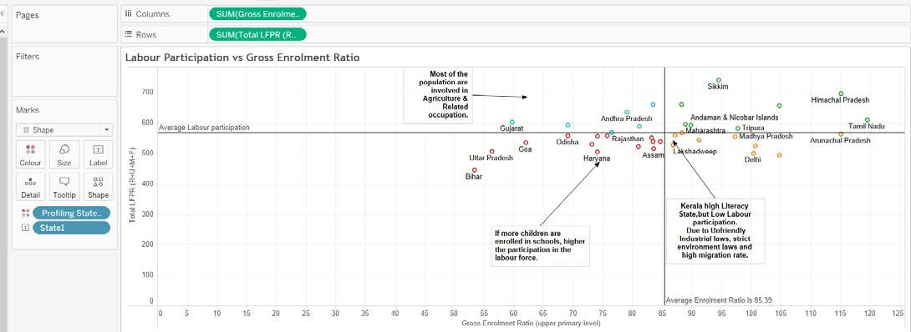
What is labour force participation vs gross enrolment ratio, mean year in school, literacy rate and poverty line?
Labor force participation vs gross enrolment ratio
•Some of labour power ratio can be affected due to many other factor in spite of a high literacy rate as an example Kerala State has really high literacy but they have low labour power ratio because of their strict in- state industrial laws, labour laws, high raw material cost for manufacturing, high migration rates etc.
•In Tamil Nadu the literacy rate and the labour power ratio is significantly high so at most everyone gets enrolled in education and get an employment afterwards.

Slide 19
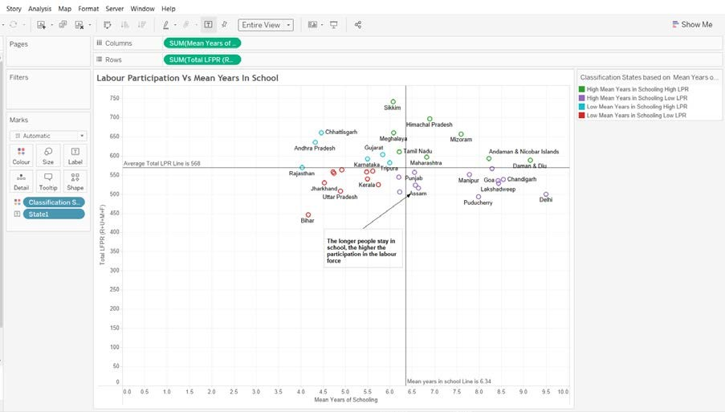
Labour force participation vs mean year in school
The longer people stay in school, the higher the participation in the labour force.
In State of Kerala the Mean years in Schooling is lesser and have higher literacy rate but due to the other external in-state regulations they have lesser labour force.
A reference line is being used just to illustrate how narrow the differences are but making a whole new difference.

Slide 20
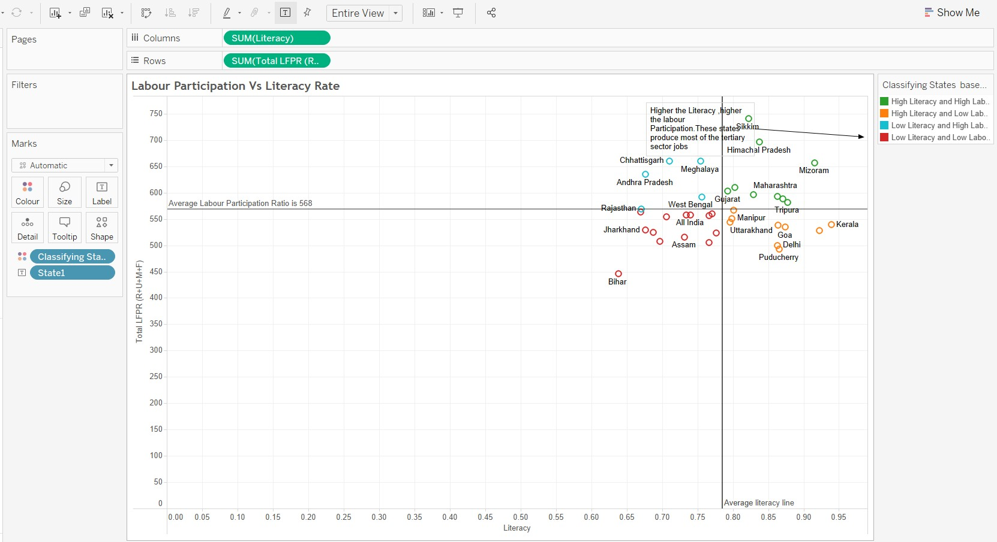
Labour force participation vs literacy rate
Higher the Literacy, higher the labour Participation. These states produce most of the tertiary sector jobs.
Some States have higher labour force but less rates of literacy.
Landing a job in other sectors is always been an issue.

Slide 21
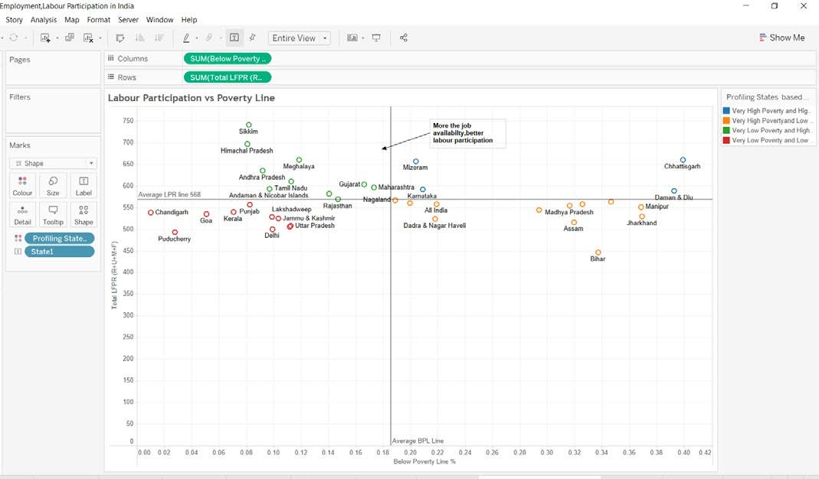
Labour force participation vs Poverty Line
More the job availability, better labour participation.
In Puducherry the population is low and the poverty ratio is also low but since there is less population the labour participation is less.
When we have better literacy rate we’ll have better jobs with better jobs we have less number of poverty occurrence.

Slide 22
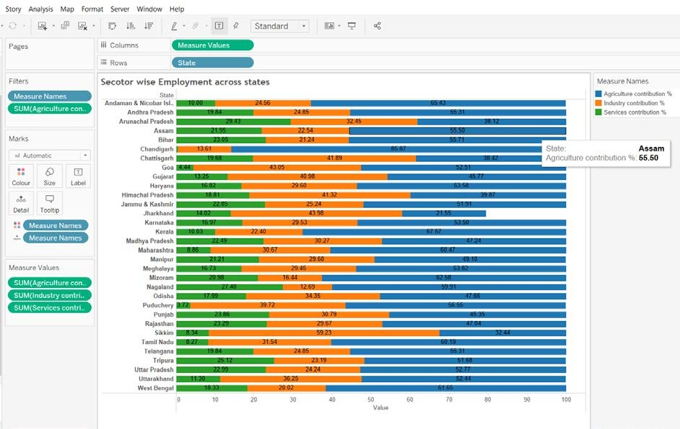
What are the three major sectors people fall under?
On average 50% of the population in each state involved in agriculture & related sector. Industrial output from Tamil Nadu is highest than other developed states.
Industry and service jobs indicates labour force advancement which is a good indicator of development.
North India depends on Agricultural sector for employment.
Since north India has higher number in Agricultural sector that has a huge impact in the overall literacy rate.

Slide 23
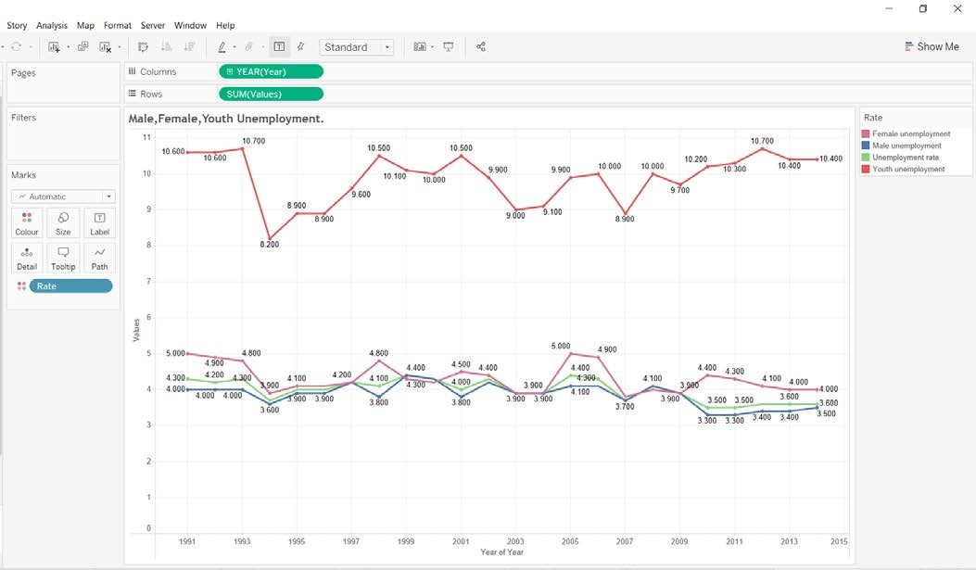
How is the unemployment rate fluctuate throughout the years?
The Unemployment Ratio between Male and Female are more or less similar and has an even number of fluctuation.
The overall youth unemployment has been stabilized for the past few years between 2007 and 2015 this is because of the increasing literacy rate because more people are going away from agriculture these years.

Slide 24
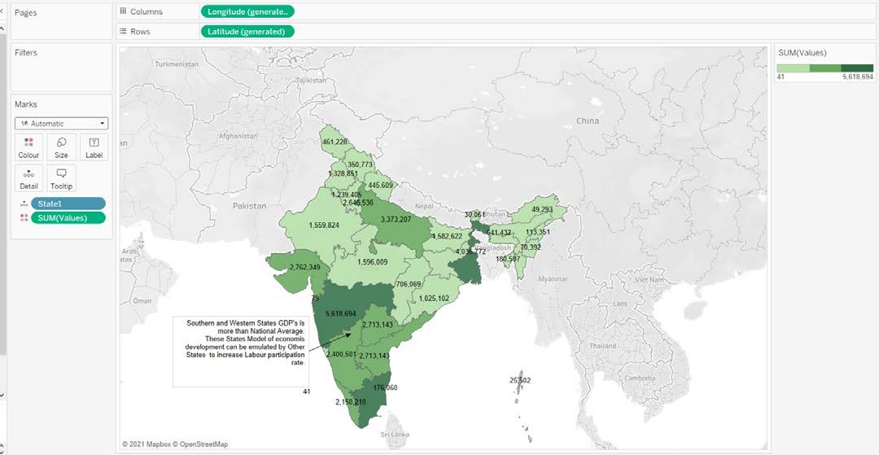
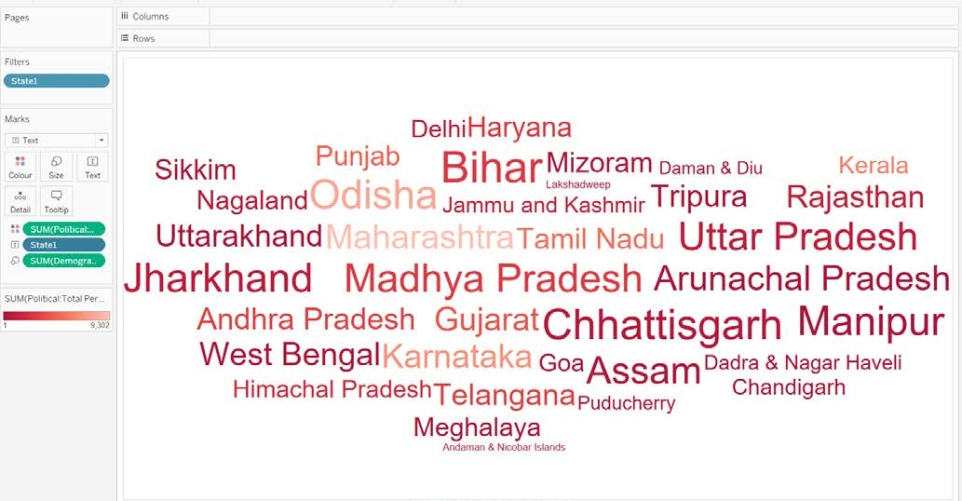
How corruption is affecting the employment?
Overall GDP of the States
Unemployment Vs Corruption Word Cloud
All the Dark green states contribute more GDP% to the entire country’s national average.
If we consider our previous research we can understand that these states have enough labour participation along with an impressive number of literacy rate hence they contribute more via industrialization.
The state titles with higher number of corruption rate is denoted with a larger size with more bold colour
These states have higher number of corruption rate and unemployment too.
Due to the corruption there is a shortage of literacy hence there is unemployment and many of these states depend on the agriculture.

Slide 25
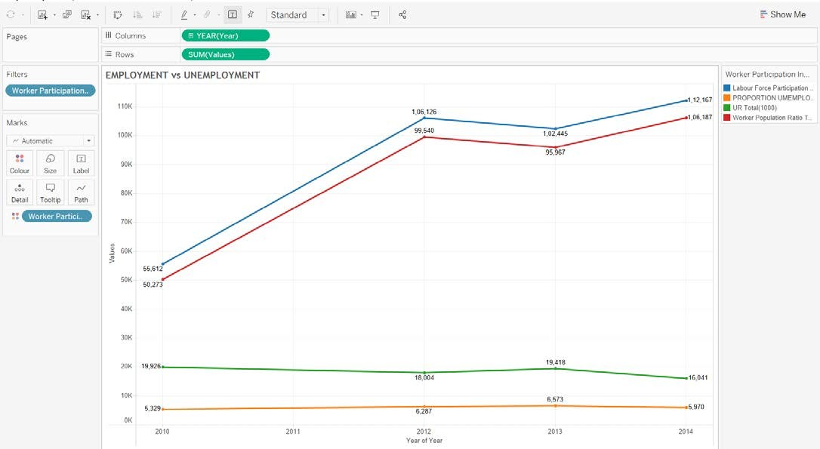
Employment vs Unemployment and how unemployment can be decreased to improve the country’s GDP?
As we can see that both the labour force participation and work force population is getting increased dramatically over the past few years..
The majority of the labour force participation is in the agriculture sector and the work force is an outcome of the other two sectors, hence there are a high number of illiteracy rate which furthermore causes an impact in the employment exchanges as many of the labour force come from agricultural background that doesn’t need any study.
As we see both the forces gets increased but the unemployment ratio and the employment proportion for unemployment hasn’t changed much for the mentioned years that is because with higher work force andhigher literacy rated states have these parameters low but our whole intention is to bring this parameters even further in all over Indian States.

Slide 26
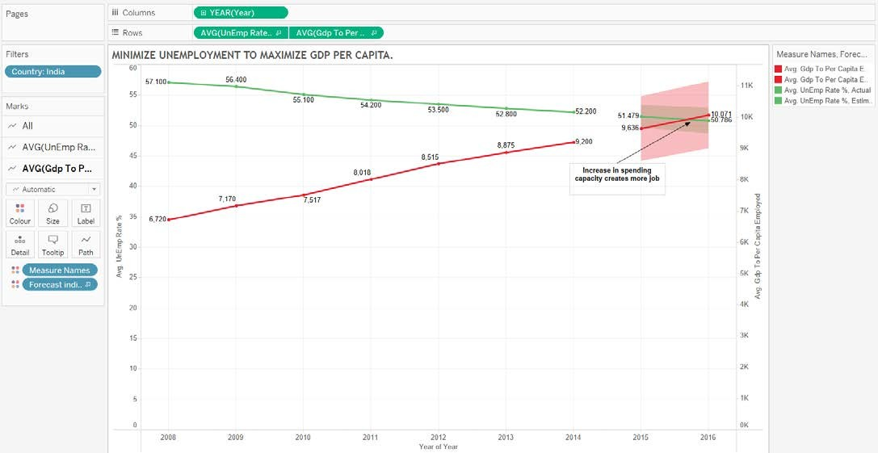
How unemployment can be decreased to improve the country’s GDP?
When the already existing work force are indulged in the work it creates more productivity in the country hence the government get profits and taxes.
Ditching the corruption and contributing the growing GDP for improving job opportunities for all the people.
Hence higher the GDP expenditure then the unemployment will gradually decrease just like we have illustrated in the chart.

Slide 27
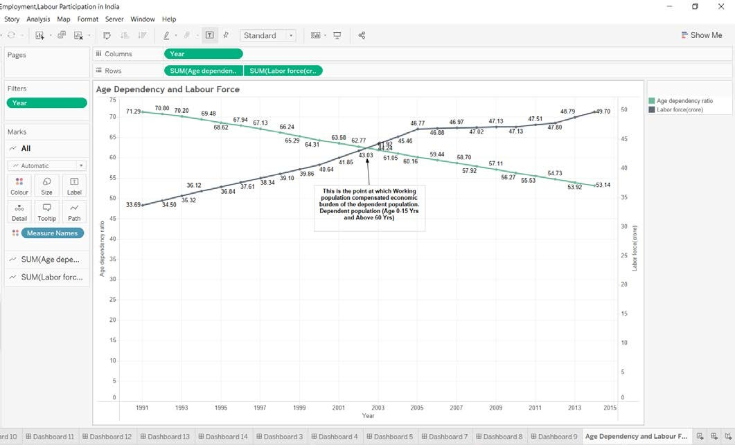
Age Dependency impact on labour force & how literacy is affecting the agriculture?
Dependent population are generally economic burden to developing world. But India consider it has future workforce. People have moved away gradually from agriculture related activity. This is due to increase in literacy rate and more job creation.
There is a flaw in this system, by high literacy rate the job creation using good GDP is fine but still the issue is this all costs a huge impact in the agricultural sector, so demand for food materials is eventually high were the country may be in a situation to import food goods from abroad which will gradually increase the overall money inflation and food costs in the country.

Slide 28
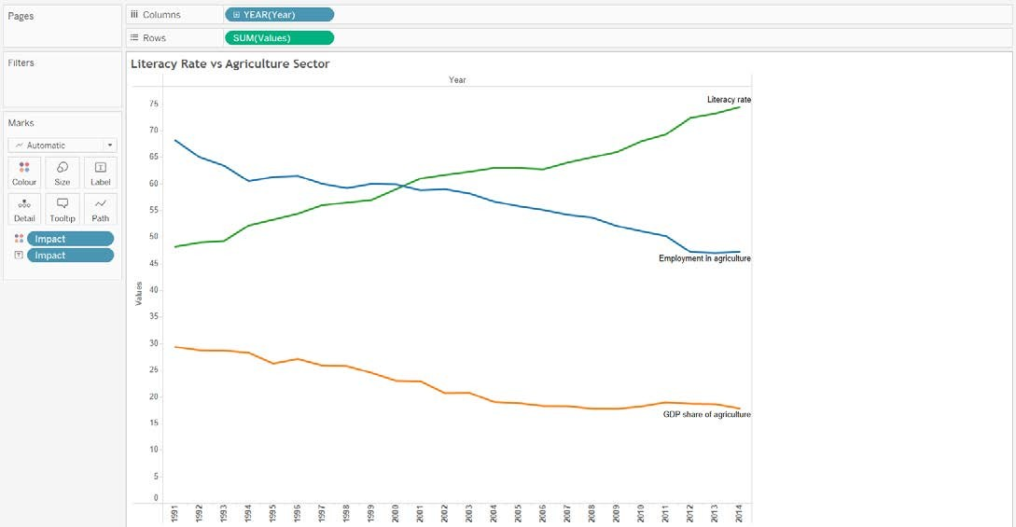
How literacy is affecting the agriculture
As we see when the literacy rate is increased the employment in agriculture is being reduced dramatically
The overall agricultural GDP contribution has taken a devastating toll in the chart due to this reason
This may actually result in a high GDP Average In overall country’s job sector but the import of food may cause severe money inflation that can affect people in long term.
Agricultural sector is also important in the overall GDP production as the 87% of total land in India is meant for agriculture.
And the national occupation of India is considered to be Agriculture, poor policies and huge corporate involvements have steadily affected the profit percentages in today’s agricultural sector.

Slide 29
05
Visualization & presentation

Slide 30
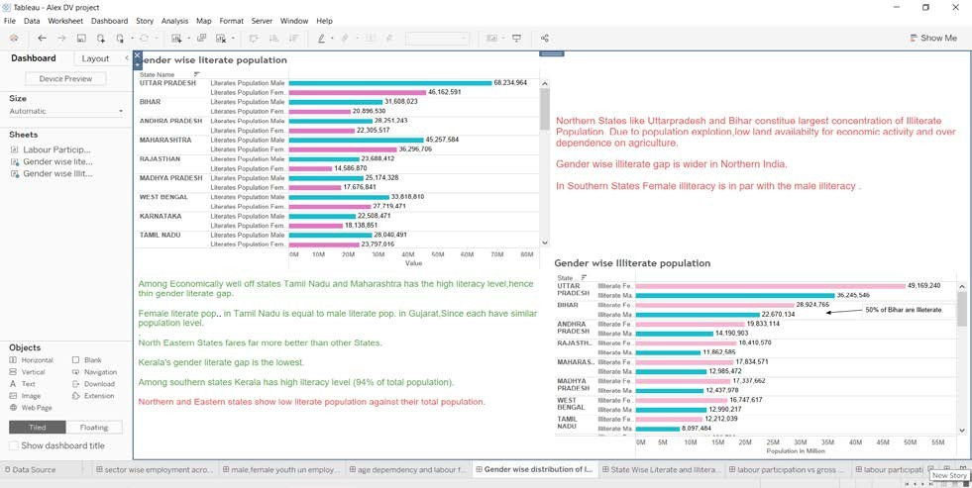
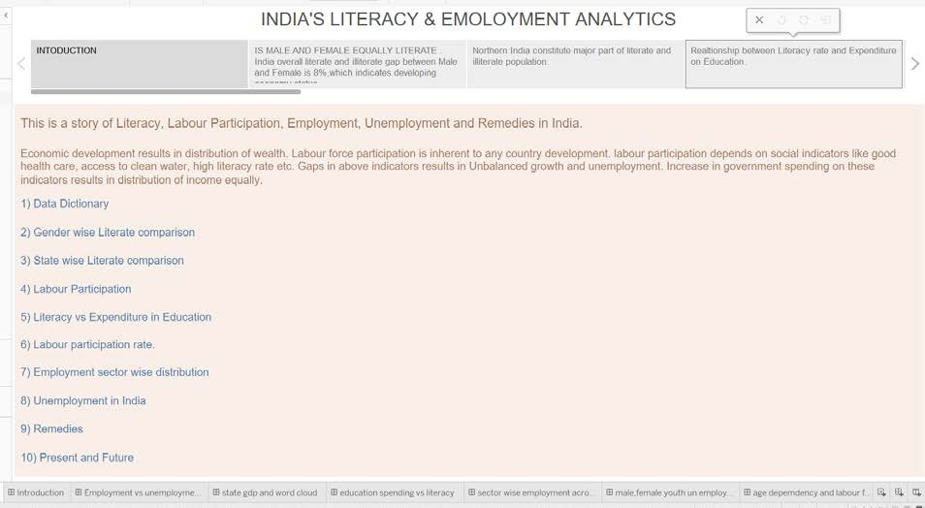
Dashboard:
STORY

Slide 31
06
Results & conclusion

Slide 32
Literacy
PROBLEM
SOLUTION
As of now unlike many other Eastern Countries like UAE etc. Gender based literacy isn’t a big issue comparatively.
Northern India constitute major part of literate and illiterate population meaning that it has equal ratio of literacy and illiteracy.
When it comes to educational expenditure government doesn’t spend much, same way majority of the literal population come from the private schools hence the % of people who couldn’t afford to go private school opt for Public schools but still the chances of having a school in all the populous states in all the district is a challenge hence the illiteracy rate.
Building more schools in rural areas.
Overall government expenditure for the Education sector has to be increased.
Encourage people to enroll their children in Public Schools and Universities.
Creating new innovative courses for children to choose from.
Better literacy rate lower the poverty occurrence.

Slide 33
Labour Force Participation
PROBLEM
SOLUTION
•Fixing the Illiteracy rate in weaker states can be useful for expansion of the services sector as it is 8th place in the top 10 countries with highest service sector with a value of 1.
•Modification of Industrial laws, Environmental laws and Managing Migration Rate should be implemented.
•Unemployment causes lesser overall GDP that constitute the wastage of the labour power so that has to be fixed.
Most of the labour comes from three major sectors Agriculture, Industrialization, Public Services.
Agricultural labour power is highest in all the States in India be it economically Weak or well developed all the states have 50% of labour power being indulged in Agriculture. Most of the population are involved in Agriculture & Related occupation.

Slide 34
Unemployment Issues
PROBLEM
SOLUTION
•Half of the population fall under the sector that has less GDP contribution and an over exploitation. Each sector’s total labour force has to be equalized so that every state can improve literacy, Literate people tend to be employed easily and contribute more to GDP. Age is just a number if you would ask me so at percent the retirement age in any sector tend to be 60 at present.
On average 50% of the population in each state involved in agriculture & related sector. Youth Unemployment is higher since India has high population of young people. Dependent population are generally economic burden to developing world.

Slide 35
State GDP and Corruption Issue
PROBLEM
SOLUTION
Increasing literacy rates contributes in fighting corruption
Dealing with unemployment.
Creating Job Opportunities in all the sectors
Strict rules has to be implemented on corruption
•Southern and Western States GDP's is more than National Average.
Economically starving states show higher corruption rate and unemployment.
•Corruption wastes our taxes or rates that have been earmarked for important community projects – meaning we have to put up with poor quality services or infrastructure, or we miss out altogether.

Slide 36
Conclusion
So the first step is to help the farmers to get education and government’s participation in preserving and economically developing the farmers will help them to evolve in a much GDP contributing sector.
Providing enough literacy to all the States and encourage people from enrolling into public schools and universities so the government intend to spend more on the education sector to preserve the dependent population as they are the future of the country.
To improve the overall GDP in the country instead of completely relying only on the agriculture sector by gaining literacy more people should indulge themselves in the other sectors like industry and services.
To improve industrial sector environmental policies, industrial laws and Migration issues has to be relaxed and sorted out so that it can contribute more to the GDP.

Slide 37


